Slide 1

OEE
(Overall Equipment Effectiveness)
..an excellent benchmarking tool
…..strive towards World Class Productivity

Slide 2
OEE Definition
OEE is a “Tool" to monitor and improve the overall effectiveness of your manufacturing processes.
(i.e. machines, manufacturing cells, assembly lines).
OEE is a percentage derived by multiplication of the three ratios for the factors – Availability, Performance & Quality.

Slide 3
OEE Calculation Method
Loading Time = Operating Time – Scheduled down time
Scheduled down time are
Preventive maintenance,
Lunch / Tea break
No power,
No schedule
Meetings etc..
Availability Rate (A) = (Loading Time – Down time)/ Loading Time
Down time are
M/C Break Down
Change Over
Material Shortage
Manpower Shortage
Others

Slide 4
OEE Calculation Method
Performance Rate (P)= Actual Prod. Qty/ Standard Prod. Qty
* Std Production Qty according M/C design cycle time .
Quality Rate (Q)= OK Prod. Qty/ ( OK + Defective) Prod. Qty
OEE = Availability Rate (A) X Performance Rate (P) X Quality Rate(Q )

Slide 5
OEE Calculation (Example)
Calculate the shift OEE of the machine by considering following data :
DATA
DETAILS | TIME REQUIRED
Shift time | 8.5 hrs = 510 Minutes
Tea breaks | 2 nos @ 10 Minutes = 20 Minutes
Meal break | 1 no. @ 30 Minutes = 30 Minutes
Equipment Failure | 15 Minute
Set up & Adjustment | 2 nos @ 15 Minute = 30 Minutes
Tool change | 15 Minutes
Standard cycle time | 20 second
Production qty achieved | 920 Units
Rejection qty | 80 Units

Slide 6
OEE Calculation (Example)
Loading time = Operating Time – Scheduled down time
= 510 - 50 = 460 min
Scheduled down time are
Meal Break : 30 Min, Tea break : 10+ 10= 20Min
Availability Rate (A) = (Loading Time – Down time)/ Loading Time
=( 460-60)/460 =0.86
Down time are
Equipment Failure : 15 Min Break Down
Set Up & adjustment : 15+ 15 =30 Min , Changeover :15 Min
Performance Rate (P)= Actual Prod. Qty/ Standard Prod. Qty
= 1000/ 1200 =0.83
* Std Prod. Qty = Working time / Std Cycle time =(400*60)/20=1200
Quality Rate (Q)= OK Prod. Qty/ ( OK + Defective) Prod. Qty
= 920 /(920+80)= 920/1000=0.92
OEE = Availability Rate (A) X Performance Rate (P) X Quality Rate(Q )
= 0.86*0.83*0.92*100 = 66%

Slide 7
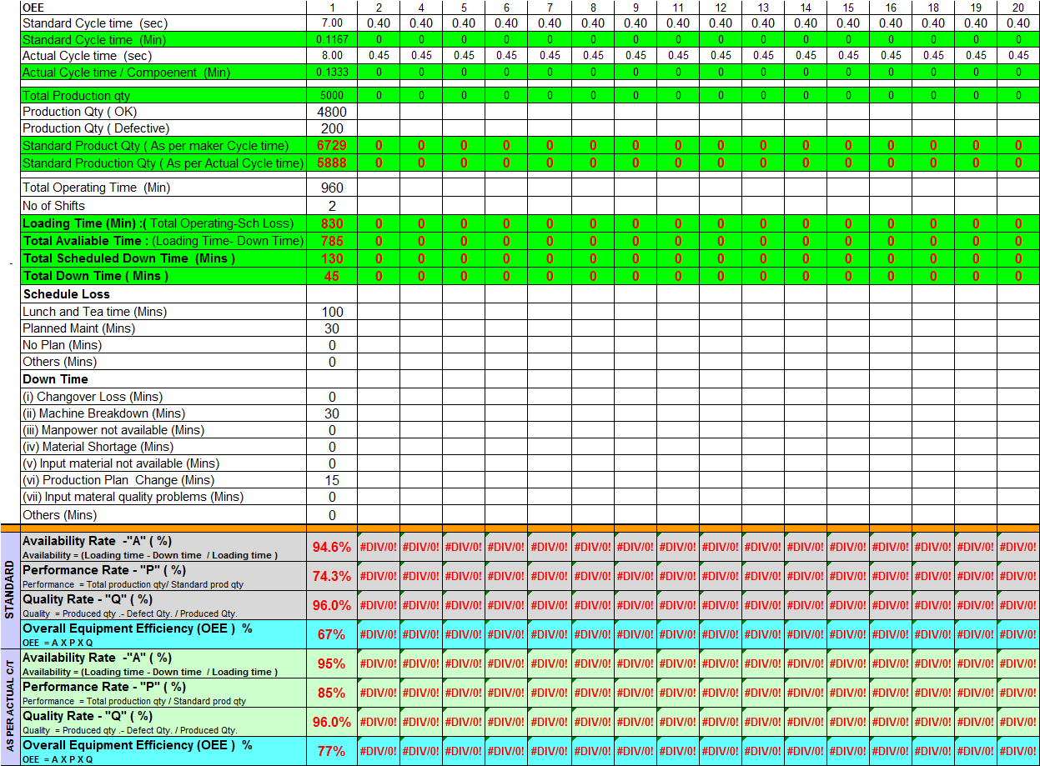

OEE Calculation Std Format

Slide 8
THANKS

